Slide 1

GDB and Git
Michael Baccia

Slide 2

Who am I?
Vice President of LUG
Final year at UIC! ;(
Interest in Security
Shameless plug for my SIG

Slide 3
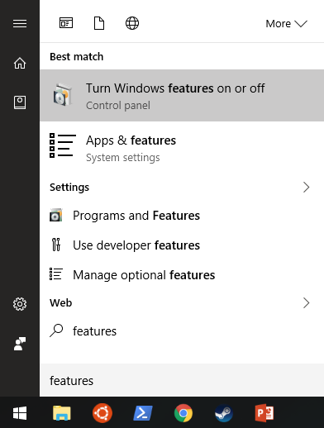
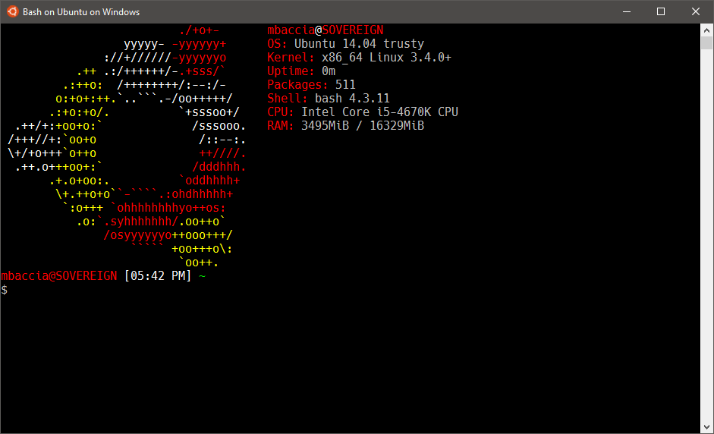
No Linux? No problem!
Windows 10 recently added Bash for Windows with the Anniversary update!
Enable in control panel under Programs and Features -> Turn features on or off:

Slide 4
What is GDB?
GNU Project DeBugger
Multi-Platform debugger for C, C++, Objective-C and others.
Command-line interface
Many debugger act as a graphical interface to GDB, while others can interface with it!
Xcode debugger (front-end)
Eclipse, Netbeans, Qt Creator, Visual Studio (interface)

Slide 5
#1 Takeaway
For more help on a command, use the help command!
help <command>
Read the manual!!!

Slide 6
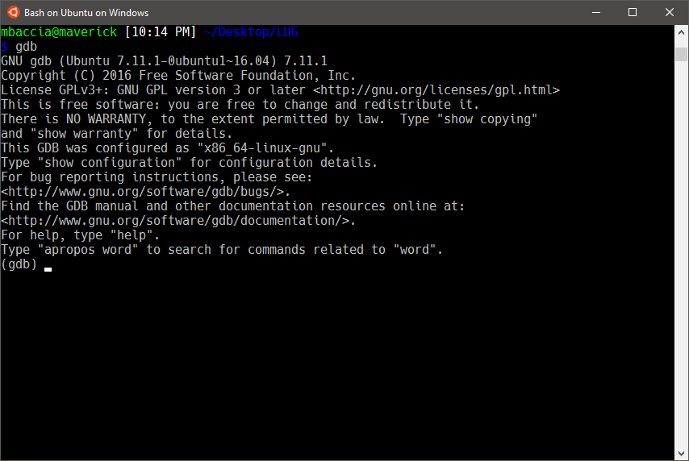
Interface

Slide 7
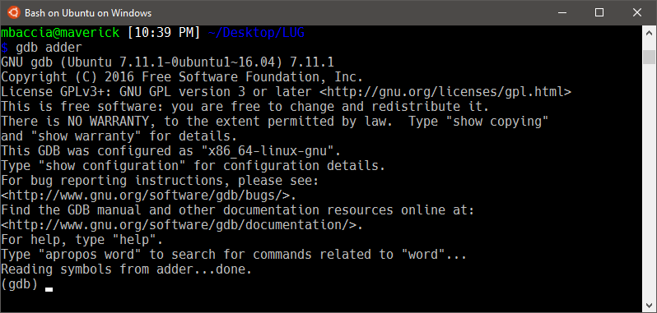
Basic Commands
Load a binary into gdb:
gdb [binary]
Tip:
Compile with gcc using the –g flag to generate debugging symbols!

Slide 8
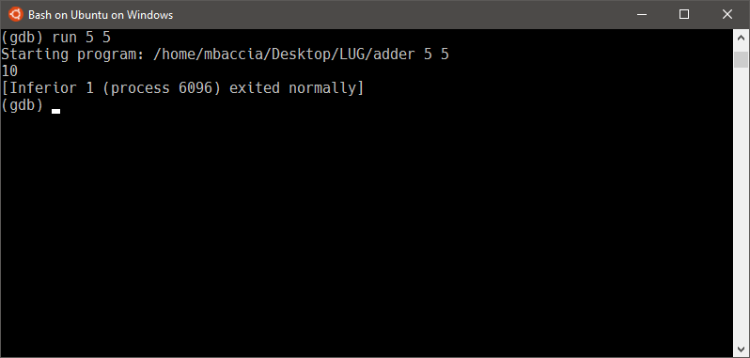
Basic Commands
run [param1 ] […param n]
begin execution of program with optional arguments.
Tip:
Use Ctrl + L to clear your screen!

Slide 9
Flow Control
break <location>
Creates a breakpoint in the program, halting when execution reaches <location>.
The breakpoint can be specified in a couple of formats
By function name (ex. break main)
By source code line (ex. break 15)
Break is actually more flexible than this, see the help for more information.

Slide 10
Flow Control
clear <location>
Clears a previously set breakpoint
continue
Resumes execution after a breakpoint

Slide 11
Flow Control
step [n]
Step through n (default 1) lines in the source code.
Note: step will step into any embedded functions
Example: foo(bar(var));
next [n]
Similar to step, but will not step into embedded functions.

Slide 12
Printing
list <location>
Lists lines (default 10) of source code starting at location.
Use set listsize to change the default.
Location is specified similar to break.
disassemble [location]
Lists assembly instructions focused around location (or current execution line if none specified).
info <command>
Many subcommands available, although most used one will probably be reg (info registers).
p <expression>
Prints the value of the expression.
p buf (print the value of buf)
p &buf (print the address of buf)

Slide 13
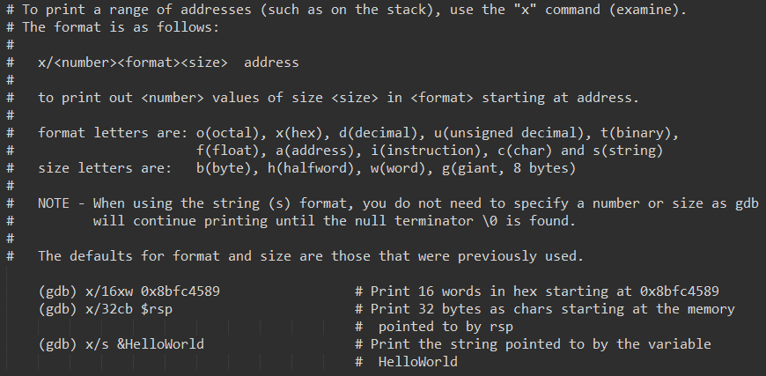
Printing
x/<format> <address>
Print out value in the specified format at address.

Slide 14
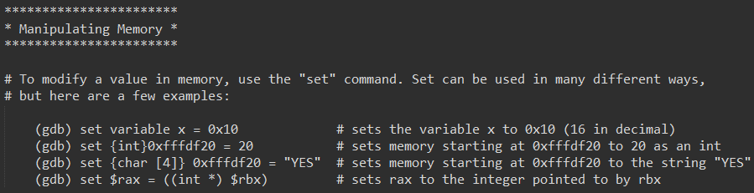
Manipulating Memory
set
Sets a variable, address, register etc. to the specified value
Can look a little messy

Slide 15
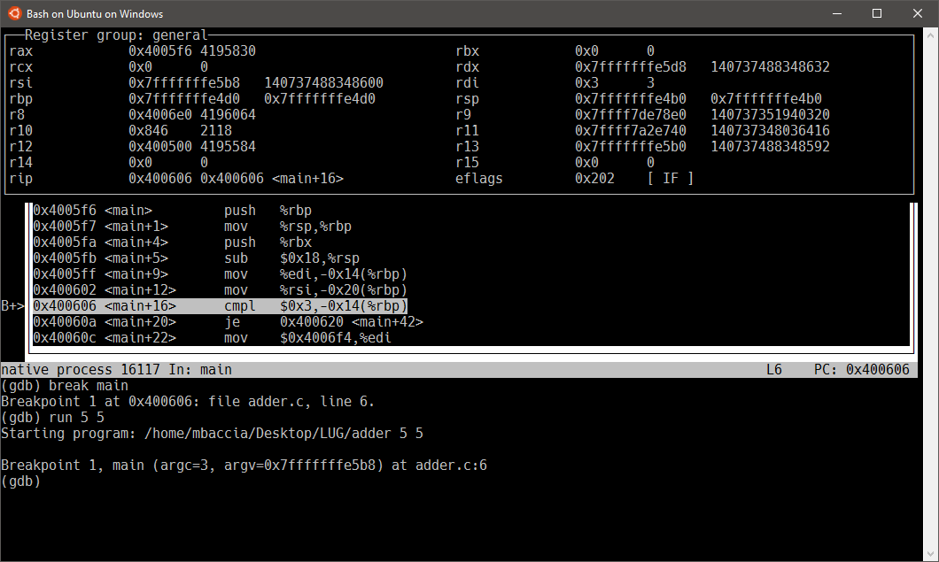
Layouts
layout <asm | regs | src | split>
Displays assembly, registers, source code or a combination of them!
focus <asm | regs | src | cmd | next | prev>
Change focus to specified pane.
Tip:
Use ‘Ctrl + x’ followed by ‘a’ to return to the normal interface.

